Slide 1
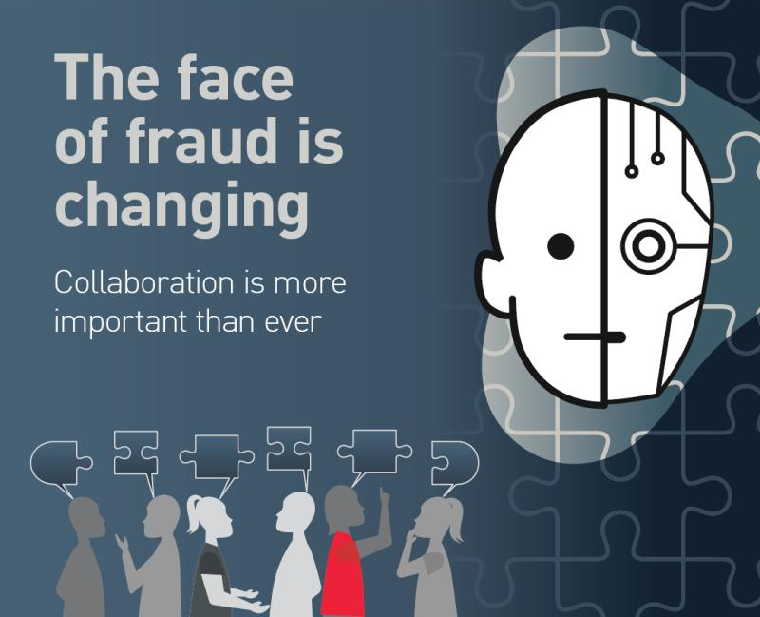

A note to users of these slides
The Crime and Corruption Commission (CCC) acknowledges the work of the Commonwealth Fraud Prevention Centre (CFPC) as the creator of this year’s Fraud Awareness Week theme and brand.
The CCC has adapted this theme in recognition of the importance of their message about collaboration.
The CCC encourages Queensland’s public sector to work with, and learn from other sectors to prevent, detect and respond to fraud and other corruption.
Agencies are free to use these slides in communicating about fraud with their employees so long as acknowledgement of the CFPC and the CCC is included.
Licensed under Creative Commons Attribution 4.0 International
Notes:
The Crime and Corruption Commission supports and encourages the dissemination and exchange of information. We are committed to routinely and proactively sharing information to the maximum extent possible.
This PowerPoint slide deck is licensed under a Creative Commons Attribution 4.0 International licence (CC BY 4.0).
You must keep the copyright notice on the copyright material and attribute Crime and Corruption Commission (Queensland) as the source of the copyright material.
More Information is available: www.ccc.qld.gov.au/copyright or please check the Creative Commons website: <https://creativecommons.org/licenses/by/4.0/>

Slide 2
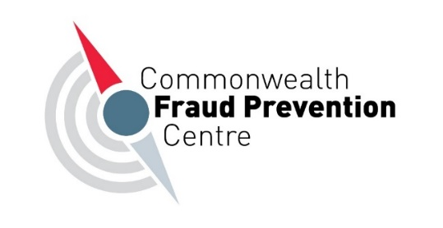
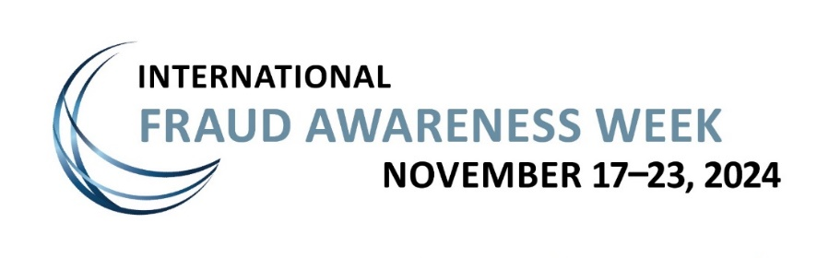


Fraud Awareness Week
The face of fraud is changing:
Global, national and state collaboration is more important than ever
Notes:
International Fraud Awareness Week is happening from 17 to 23 November 2024. It encourages entities to minimise the impact of fraud by promoting fraud awareness and education.

Slide 3


Acknowledgement of Country
© Crime and Corruption Commission (Queensland)
Notes:
[Note to presenters: Please do amend the above to your agency’s acknowledgement of country and include the peoples of the land on which you are presenting].
In keeping with the spirit of Reconciliation, I respectfully acknowledge the Jagera (JAG-EH-RAH), Yugara (YUG-EH-RAH), and Turrbal (TUR-A-BUL) peoples as the Traditional Owners and Custodians of the land on which
this event is taking place, and Elders past, present and emerging. I also recognise those whose ongoing effort to protect and promote Aboriginal and Torres Strait Islander cultures will leave a lasting legacy for future Elders and leaders.

Slide 4
The face of fraud is changing
Technology and innovations are advancing the way we deliver efficient and effective public services to our communities.
They are also increasing fraud-related risks for the public sector.
Notes:
In the lead up to International Fraud Awareness Week held from 17-23 November 2024, the Crime and Corruption Commission has shared some resources with the public sector to help us prevent, detect and respond to new and emerging fraud threats. The theme of International Fraud Awareness Week is ‘The face of fraud is changing – collaboration is more important than ever.’
Fraud doesn’t just affect finances; it erodes public trust in government institutions. It also places a financial burden on the public sector, which means less funding for essential services. With rapid technological advancements, the face of fraud is shifting, which makes it more important than ever to stay ahead of these evolving threats.
While advancements in technology and innovations in public service delivery are helping the public sector to deliver more efficient and effective services, they also increase fraud-related risks for agencies by making it more difficult for fraudulent activity to be detected, investigated and prosecuted. This is because advanced technology can offer a dangerous combination of anonymity, psychological distance, speed and efficiency, and personalisation not seen before. This combined with current economic conditions, such as the rising cost of living, may increase the motivation for fraud by public sector employees or contractors.
Over the next few slides, we’ll explore how fraud is evolving, the impact on publicly funded institutions, and the role we each play in preventing, detecting, and responding to fraud.

Slide 5
The CCC received more than 2500 fraud-related allegations from 2015-2023
Notes:
While the face of fraud is changing, it’s important to understand how that relates to fraud in Queensland.
This graph shows the fraud-related allegations made about the public sector to the CCC since 2015. Between 2015 and 2023, the Crime and Corruption Commission received over 2500 fraud-related allegations.
While fraud allegations peaked between 2018 and 2020, since 2022 the CCC has been observing an increasing upward trend in fraud-related allegations. As the opportunities to commit and detect fraud change, it is critical that public sector agencies ensure they have the right measures in place to detect, prevent and respond to fraudulent behaviours.
[Note to presenters: To see your sector/department’s fraud-related complaints (and other corrupt conduct), view our Corruption Allegations Data Dashboard (CADD) <https://www.ccc.qld.gov.au/about/corruption/corruption-allegations-data-dashboard>. You can use this information to add and tailor your presentation to your sector or specific department or agency.]

Slide 6

Do you know how the face of fraud is changing?
The following areas are particularly prone to the changing face of fraud:
Procurement
Recruitment
Grant funding, regulation, and licensing.
Notes:
While technological advancements are changing almost all aspects of fraud, the CCC’s corruption work has identified three areas that are particularly prone to technology-related fraud threats:
Procurement
Recruitment
Grant funding, regulation, and licensing.

Slide 7

Fraud risk - Procurement
Complex procurements, including major infrastructure and development projects are vulnerable to fraud as they involve significant investment of public funds.
Technology such as e-procurement, cloud-based procurement solutions, and increased online transactions can increase fraud risks in procurement.
Notes:
Significant public funding is invested in delivering major infrastructure, which includes new hospitals, schools, housing, transport, and renewable energy. Complex procurements, including major infrastructure and development projects are vulnerable to fraud and corruption as they often involve significant expenditure of public funds.
Advancements in technology mean that agencies are increasingly relying on e-procurement processes, cloud-based procurement solutions to automate procurement tasks, increased online transactions and online document submissions and recordkeeping. However, these same advancements increase technology-related procurement risks, especially in supplier selection and contract management.
Procurement-related frauds include:
creating fraudulent physical or electronic documents
altering existing physical or electronic documents
manipulating the bid documents such as technical specifications
inappropriately accessing or releasing sensitive or confidential information, e.g., tender specifications .

Slide 8
Fraud prevention - Procurement
You can reduce the risk of procurement fraud by:
Implementing a fraud and corruption risk management plan.
Setting a procurement policy and procedure that guides staff on how to conduct procurement activities.
Promoting a probity-oriented culture through training and awareness.
Developing and implementing internal control activities – e.g., internal audits, securing/tracking access to sensitive documents and auditing access.
Notes:
The CCC promotes a four-step approach for implementing control mechanisms that will assist your agency to reduce the risk of fraud and corruption within procurement.
Implement a fraud and corruption risk management plan that documents how you identify, prevent and respond to fraud risk.
Set a procurement policy and procedure that guides staff on how to conduct procurement activities.
Promote a probity-oriented culture through training and awareness.
Develop and implement internal control activities such as internal audits of your processes, securing of and tracking of access to sensitive documents and information management and auditing that access.

Slide 9

Fraud risk - Recruitment
Recruitment is a high-risk area for fraud through people misrepresenting their qualifications, work history and experience.
It can also be heightened where checks are not properly undertaken by the employing agency.
Notes:
Recruitment is a high-risk area for fraud through people misrepresenting their qualifications, work history and experience. Our corruption work has identified how technology can facilitate or conceal corruption through:
using technology to create false tertiary qualifications to gain employment
employees holding multiple undeclared and unmanaged remote working arrangements enabling people to hold multiple jobs in different organisations at the same time.
‘ghost’ employment fraud where positions are created and then ‘filled’ by staff who either do not work for the organisation or do not exist, and whose wages are paid to corrupt employees due to automated recruitment, employment and payroll systems.
Fraud in recruitment may be heightened where an agency doesn’t:
undertake sufficient pre-recruitment vetting and screening
validate credentials and work-experience
apply the same probity rigour to internal applicants
ensure managers adequately supervise staff and their outputs
ensure recruitment agencies carry out proper due diligence checks on applicants or adequately oversee their service delivery

Slide 10
Fraud prevention - Recruitment
Reduce your risk of recruitment fraud by ensuring your agency has:
pre-employment screening and vetting
a recruitment and selection policy and procedure
induction and ongoing training
obligations to declare conflicts of interest, secondary employment and declarable associations
internal audits.
Notes:
The following strategies can reduce your agencies risk of fraud and corruption within recruitment.
Implement strong pre-employment screening and vetting at every stage of the recruitment process.
Set a recruitment and selection policy and procedure to guide staff on how to conduct recruitment properly.
Implement an induction process and training for new and ongoing employees to emphasise their public interest responsibilities and obligations.
Embed an ongoing obligation for employees to declare conflicts of interests, secondary employment and declarable associations and develop a process for recruitment panels to declare and manage conflicts of interest.
Develop and implement the right internal control activities such as internal audits of your processes, securing of sensitive documents and auditing employee access.

Slide 11

Fraud risk - Grants, regulation & licensing
Corruption risks are elevated when grant programs are delivered rapidly or with limited resources.
Competition for funding may increase corruption risks.
Notes:
State and local government bodies regulate a number of important activities and industries and are responsible for distributing large amounts of public funds through grants and assistance programs.
Corruption within grant funding, regulation and licensing can have significant impacts on the health and safety of individuals, the community, and the environment, and lead to the misuse of public funds.
While delivering grants, issuing licences and carrying out regulatory functions are necessary to achieve key government objectives, they also carry fraud risks as they are often highly competitive and involve the exercise of discretionary powers.
Corruption risks in relation to grant funding are often elevated when a grant program is designed and delivered rapidly or with inadequate resources. Competition for funding may increase corruption risks by creating incentives to misreport service delivery costs or outcomes, or to manipulate already funded existing services as new or additional services.
Regulatory activities, particularly those providing licensing, certificates or inspections of compliance are also potentially at higher risk of corruption or fraud due where the agency holds highly sensitive information, as well as the increased risk of bribery, favouritism or other conflicts of interest.
Common corruption risks around grant funding, regulatory and licensing functions include:
Individuals failing to declare a conflict of interest involving a person or business they are regulating or providing funding to.
Individuals soliciting or accepting a bribe or benefit to exercise their powers in a certain way.
Individuals improperly providing confidential information to a regulated entity or funding recipient.
A person acting fraudulently in relation to an application for a licence or permit.

Slide 12
Fraud prevention - Grants, regulation & licensing
To reduce fraud risks in grant funding, regulation, and licensing:
implement systems and practices to manage these activities
screen grant or licence recipients
train employees on ethical and administrative obligations
rotate employees in decision-making roles
oversight discretionary decisions to prevent conflicts of interest
conduct regular and random audits.
Notes:
The CCC recommends the following approach to assist your agency to reduce the risk of fraud and corruption within grant funding, regulation, and licensing. To reduce fraud and corruption risks in grant funding, regulation, and licensing:
Implement systems and practices to manage grant funding, regulation, or licensing effectively. Use the Queensland Audit Office Grant Management Maturity Model (www.qao.qld.gov.au/reports-resources/better-practice/grant-management-maturity-model) for self-assessment.
Screen grant or licence recipients thoroughly, both before and after awarding, to confirm ongoing compliance.
Train employees on ethical and administrative obligations, including decision-making, conflict declarations, and handling sensitive information.
Rotate employees in decision-making roles, with oversight on discretionary decisions to prevent conflicts of interest.
Conduct regular and random audits of processes and decisions.

Slide 13

The role of the public sector
All publicly funded institutions play a role in preventing and managing fraud risks.
Collaboration is key to tackling these evolving threats.
Fraud prevention is not just a reactive process – it’s about being proactive.
We all have a role to play in preventing fraud.
© Crime and Corruption Commission
13
Notes:
While the face of fraud is changing, how we prevent it remains the same: to understand the risks, and have effective controls, checks and processes in place to prevent, detect and respond to these risks.
In this evolving fraud landscape, collaboration is key. By working together and sharing information across agencies, we can better understand the risks and how to mitigate them. Additionally, by harnessing technology, we can improve our ability to detect and prevent fraud in real-time.
Each of us plays a role in the fight against fraud. Understanding how fraud occurs in your area, knowing what signs to look for, and being prepared to respond are critical steps in helping protect against fraud. As fraud continues to evolve, so too must our awareness and response strategies.
Additional to the prevention strategies relating to the three key fraud risk areas, some general strategies to prevent fraud include:
Have strong processes in place to prevent, detect, and respond to fraud.
Be proactive and agile in identifying and addressing fraud.
Collaboration across agencies is crucial to staying ahead.

Slide 14
Wrap up - Fraud Awareness Week 2024
The face of fraud is changing, but our commitment to preventing it remains strong.
Collaboration and strong processes are key to staying ahead of fraud threats.
Be proactive, stay informed, and know your role in preventing fraud.
Notes:
In conclusion, while fraud is evolving, our response remains the same: through collaboration, strong processes, and a proactive mindset, we can protect our public institutions and the services they provide. Let’s continue to work together to combat fraud and keep our government and economy safe.

Slide 15
For more information
Visit the CCC’s website and search
Fraud Awareness Week 2024
Utilise resources available through fraud prevention agencies such as fraudweek.com/resources and counterfraud.gov.au
Check out the Queensland Audit Office’s practical fraud risk assessment tools
Subscribe to CCC updates
© Crime and Corruption Commission (Queensland)
Notes:
Note to presenters: There are a number of other resources that may also assist you to tailor this presentation for your agency audience.
Procurement:
CCC Fraud and Corruption Control: Best Practice Guide (www.ccc.qld.gov.au/publications/fraud-and-corruption-control-best-practice-guide)- This guide has been designed for use by practitioners responsible for implementing or reviewing an organisation’s fraud and corruption internal controls.
CCC Information Sheet: Probity as a means of managing corruption risks in procurement (www.ccc.qld.gov.au/publications/probity-means-managing-corruption-risks-procurement)
CCC Corruption Prevention Advisory: Procurement and contract management (www.ccc.qld.gov.au/publications/corruption-prevention-advisories).
Commonwealth Fraud and Corruption Control Framework (www.counterfraud.gov.au/library/framework-2024). While the framework was designed for the Australian public sector, it is a good resource about effective corruption controls
Recruitment:
Prevention in Focus: Risks in recruitment — are you adequately vetting your staff? (www.ccc.qld.gov.au/publications/risks-recruitment-are-you-adequately-vetting-your-staff)
Corruption Prevention Advisory: Conflicting commitments - Managing other employment and volunteering (www.ccc.qld.gov.au/publications/corruption-prevention-advisories)
Corruption Prevention Advisory: Post-separation employment (www.ccc.qld.gov.au/publications/corruption-prevention-advisories)
Grant funding, regulation and licensing
Corruption Prevention Advisory: Use of Official Resources (www.ccc.qld.gov.au/publications/corruption-prevention-advisories)
Queensland Audit Office: Performance Audit Report 2: 2022-23: Improving Grants Management (www.qao.qld.gov.au/reports-resources/reports-parliament/improving-grants-management)
ICAC South Australia: Grants administration: Final report (www.icac.sa.gov.au/publications/published-reports/grants-administration-final-report)
Commonwealth Fraud Prevention Centre: Prevent fraud and corruption in grants administration (www.counterfraud.gov.au/prevent-fraud-and-corruption-grants-administration)

